Slide 1
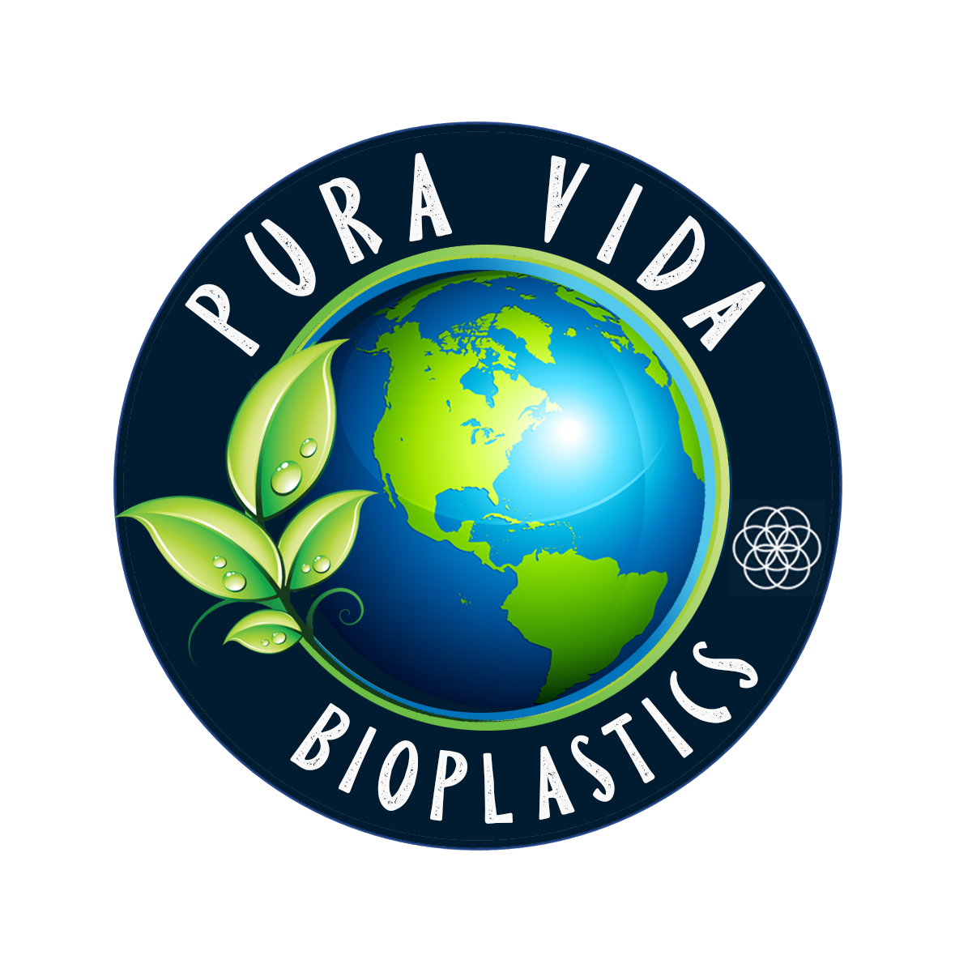
Let’s Go Beyond Green, and Redefine Plastics!
Made in the USA | Native American Owned

Slide 2
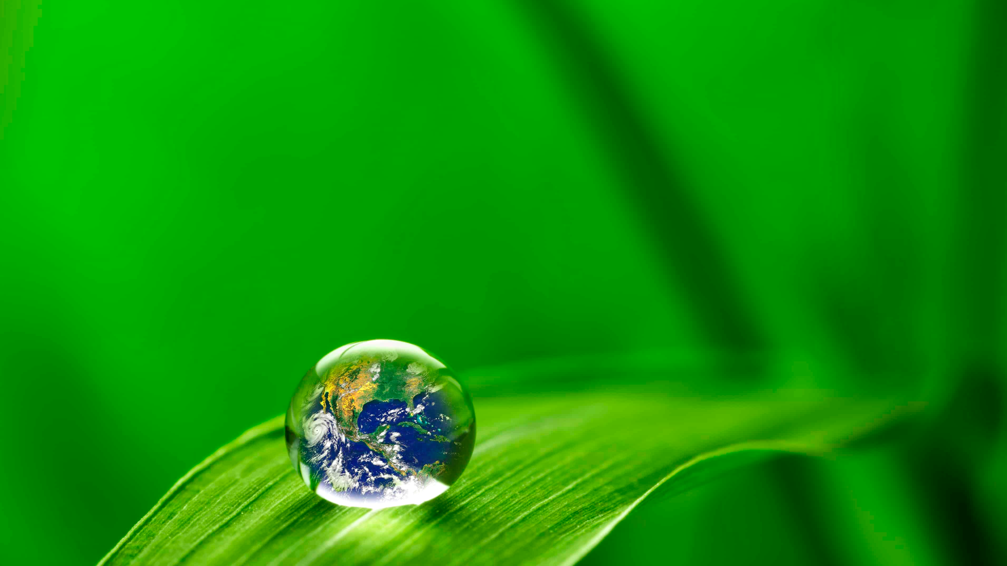
Introduction
Our Mission
To prevent plastic pollution by providing alternative bio-based products. While promoting clean-up movements around the world, Pura Vida Bioplastics is much more than a company with a product. We are a movement focused on educating consumers about the effects that single-use plastics have on the environment and how to know the difference of a truly green product, versus that of misleading greenwashed products.
Our Vision
A world devoid of plastics allowing our air to restore, our forests to rebuild, and our beautiful oceans to begin healing.

Slide 3
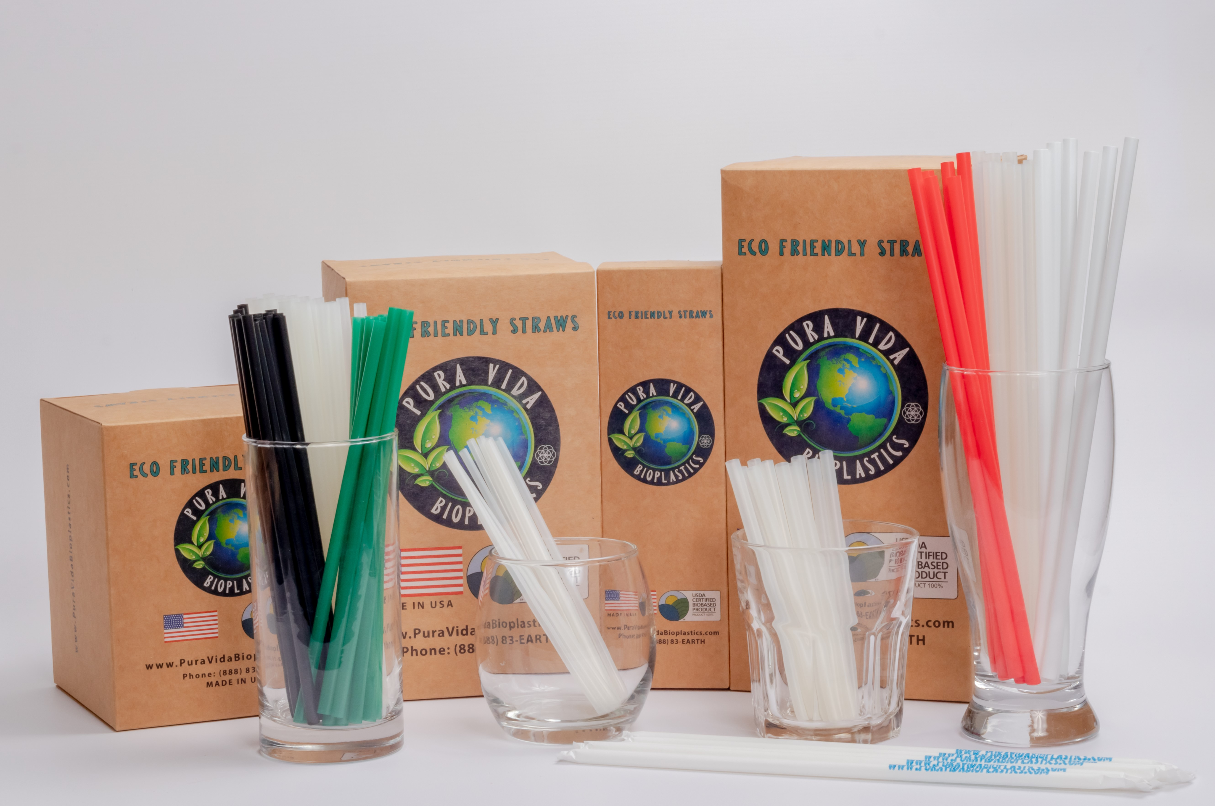
Why Us?
At Pura Vida Bioplastics, our goal is to help eradicate our world of the pollution created by plastics. Unlike others who use ‘Greenwashing’ tactics to sell products (misleading consumers into believing they contain no plastics), we at Pura Vida Bioplastics offer an industry-leading example of what is actually achievable:
• No PLA or Micro-Fragments (ex: OXO-Degradable)
• Full Transparency Is the Key Against "Greenwashing"
• Proven and Verifiable National & International Certifications
• Breaks down in 3 to 12 Months Once Exposed to the Environment
• Products Are Labeled With Natural, Home Compostable and Chemical Free Inks
• Breaks Down Into CO2 and Biomass Without Any Chemical Residue or Heavy Metals
• Stronger Than Plastics
• Non-GMO, Non-PE, Non-EPI
• Manufactured Sustainably in the USA
• Unlike Other Competitors Our Straws Hold up in Hot and Frozen Environments
• 100% Bio-Based Formulation

Slide 4
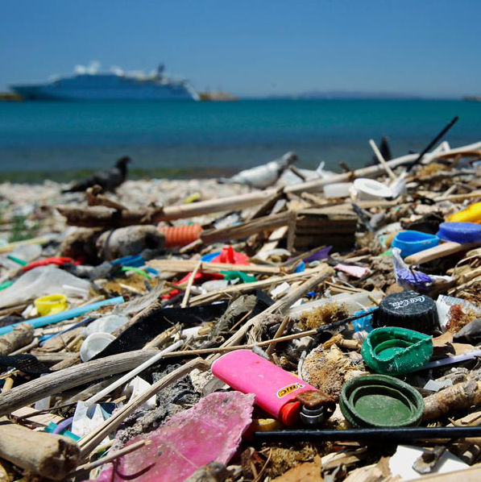
How many plastic straws are used in a day?
In the USA, 500 million plastic straws are used in a day. This is enough straw waste to wrap the circumference of our Earth 2.5 times! 500 million straws weigh about the same as 1,000 cars, which is a massive amount of plastic to throw in landfills daily. What about global consumption? If we just multiply the USA quantity by 10, this totals 5 billion straws per day…..an enormous waste issue. Globally, we all should be concerned about everyday straw usage, which worldwide, carries a heavy plastic waste burden. Pura Vida Bioplastics’ straws are having an impact.

Slide 5
How long do plastic straws take to breakdown and how harmful are they to the environment?
Plastic straws take up to 800 years to decompose.
As a time-frame reference, this image depicts a knight from approximately 800 years ago…..
PLA [Polylactic Acid] which is better than traditional plastics, takes up to 80 years to decompose.
Pura Vida straws made from PHBH
Less than 30 days in ideal home composting conditions.
Less than 1 year in aerobic or anerobic conditions.

Slide 6
How Pura Vida Eco-Friendly straws breakdown….
Our straws are home and industrial compostable. They break down into organically viable compounds within a timeframe equal to that of an organic compound, such as food waste.
In addition to degrading in aerobic conditions [with oxygen], our straws also degrade in anaerobic conditions [without oxygen], such as traditional landfills which lack oxygen.
Our straws are made from 100% bio-based renewable resources which degrade at the same rate as other natural/organic compounds found in landfills.
Our straws are made from marine degradable resin.

Slide 7
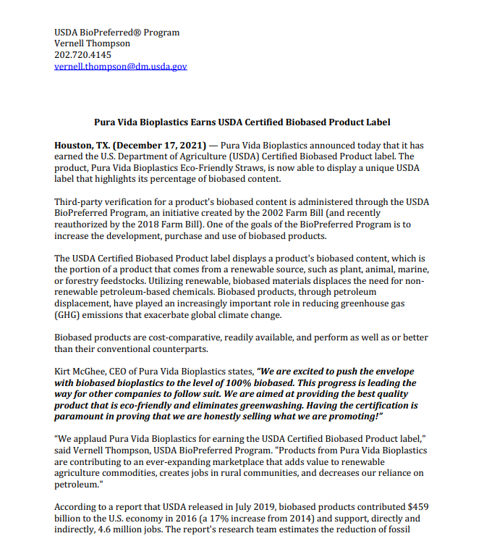
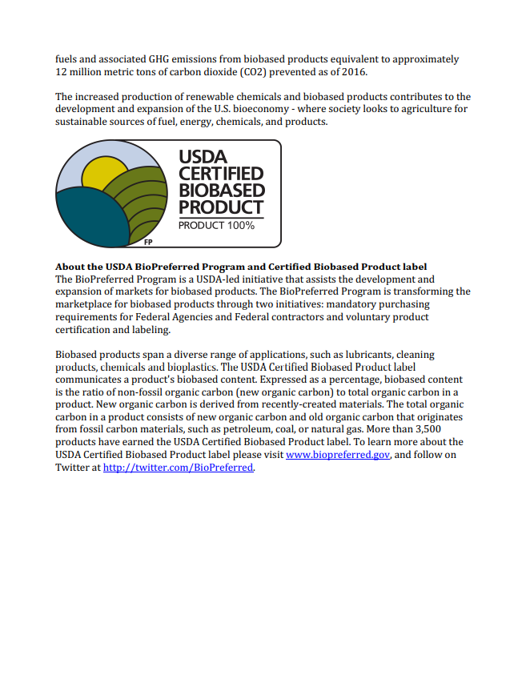
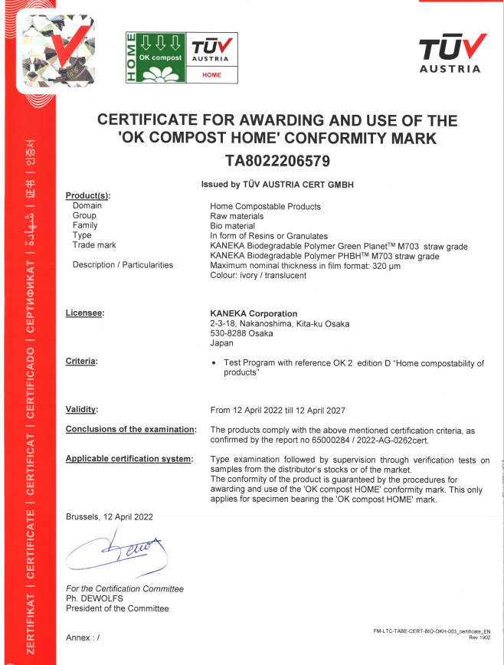
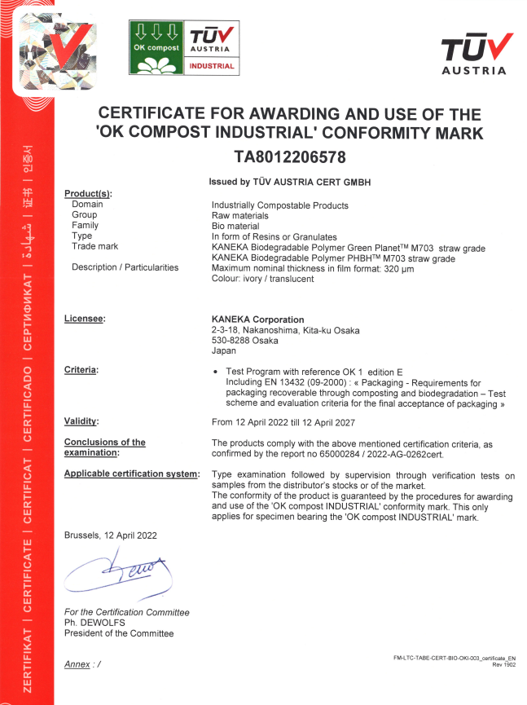
Our Certifications

Slide 8
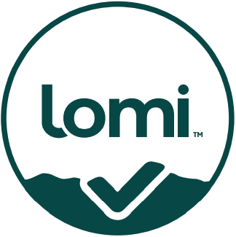
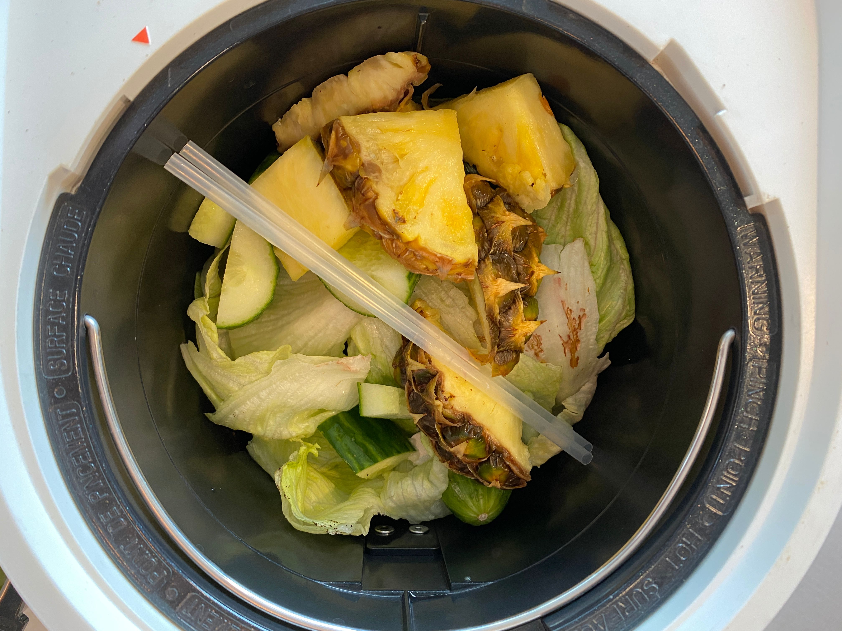
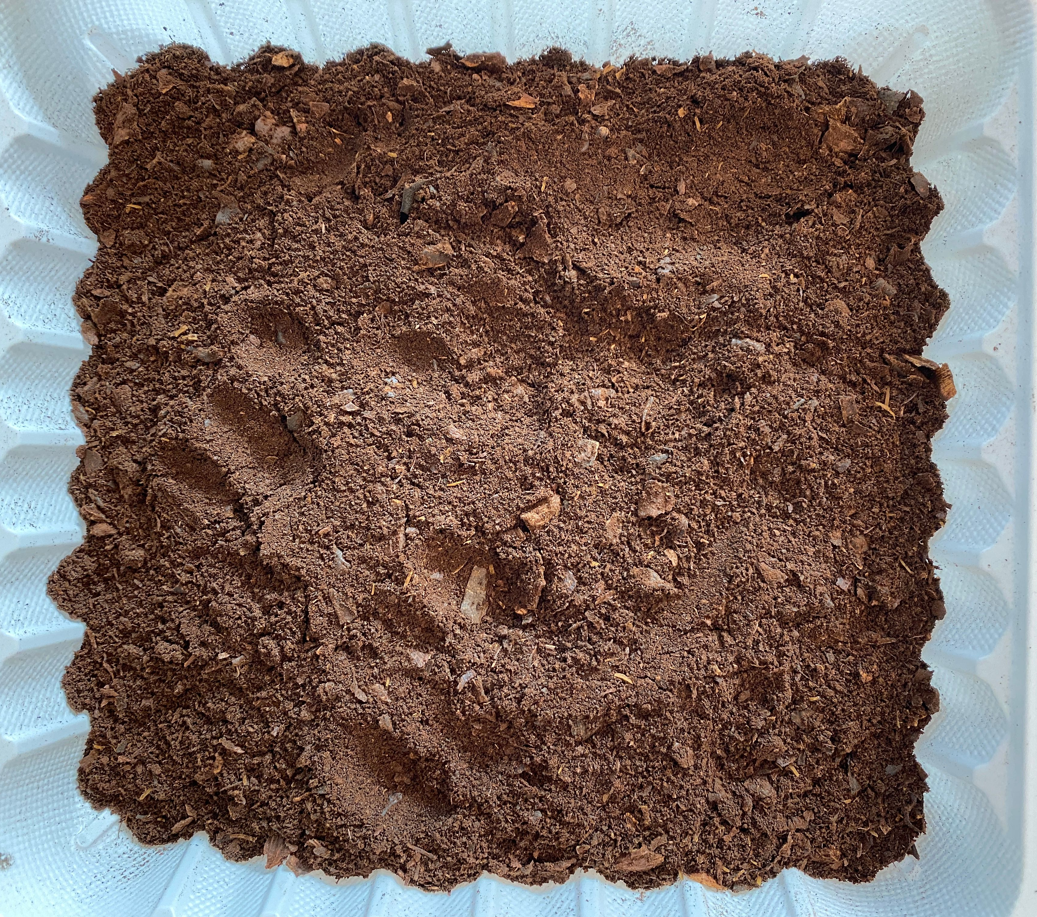
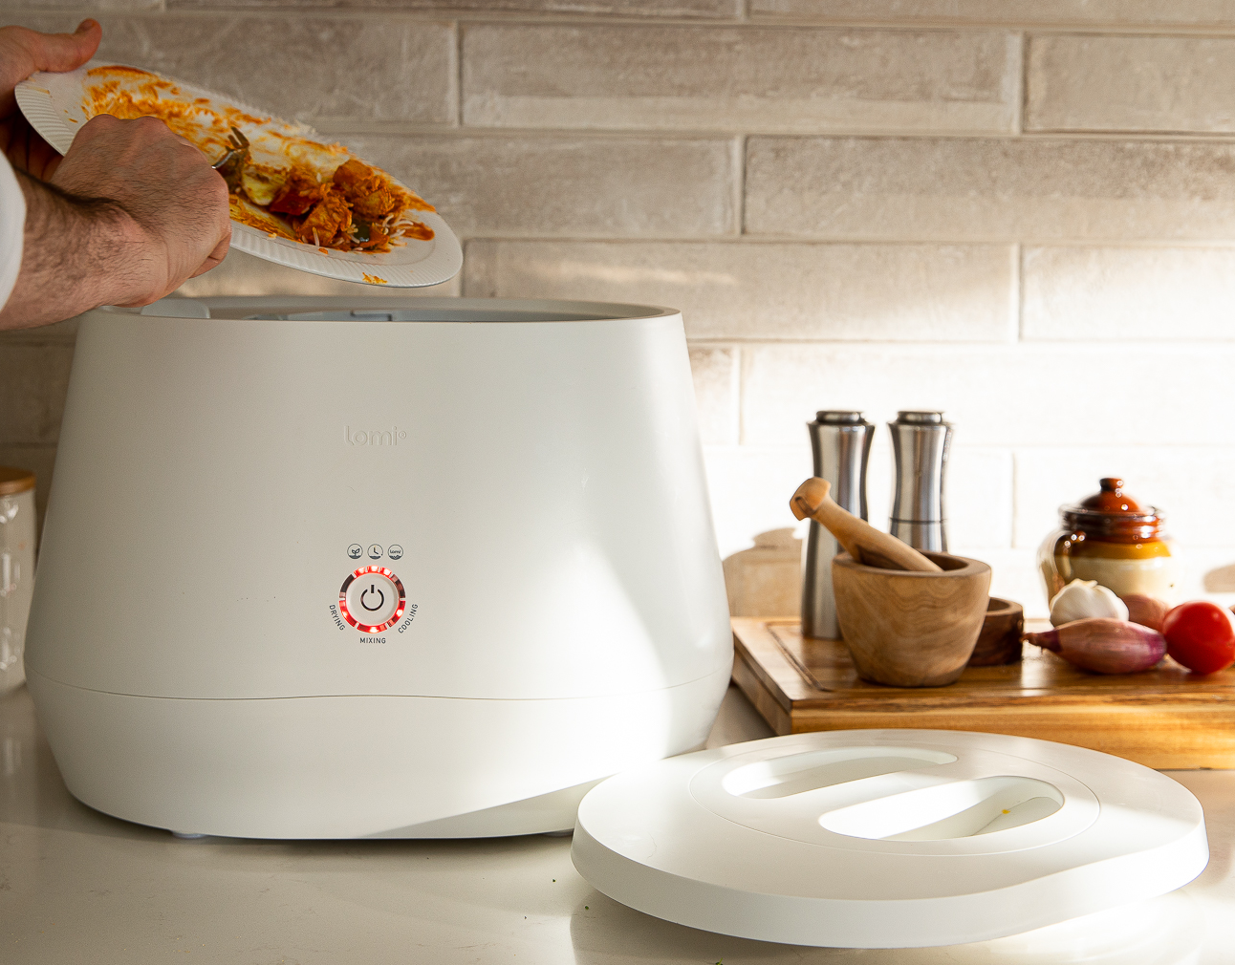
Lomi Approved
Pura Vida Bioplastics is proud to announce that our straws have been certified as Lomi Approved!
What is Lomi Approved:
Lomi Approved is a certification for non-food compostable items, including bioplastics, that can be broken down by Lomi so they can biodegrade faster and ultimately turn into dirt.
In as little as four hours your waste will turn into nutrient rich dirt.
You provide the waste - they’ll turn it into nutrient rich dirt.
Thanks to Lomi, a revolutionary appliance that turns waste into dirt - made by our friends at Pela.
(Before)
Lomi food waste cycle with
Pura Vida Bioplastic Straws
(After)
Rich Dirt

Slide 9
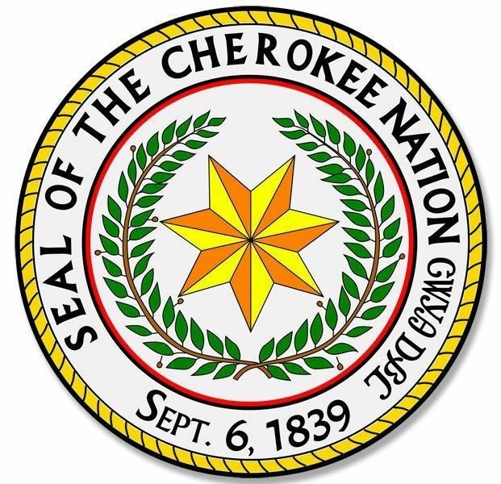
We are Minority Owned

Slide 10
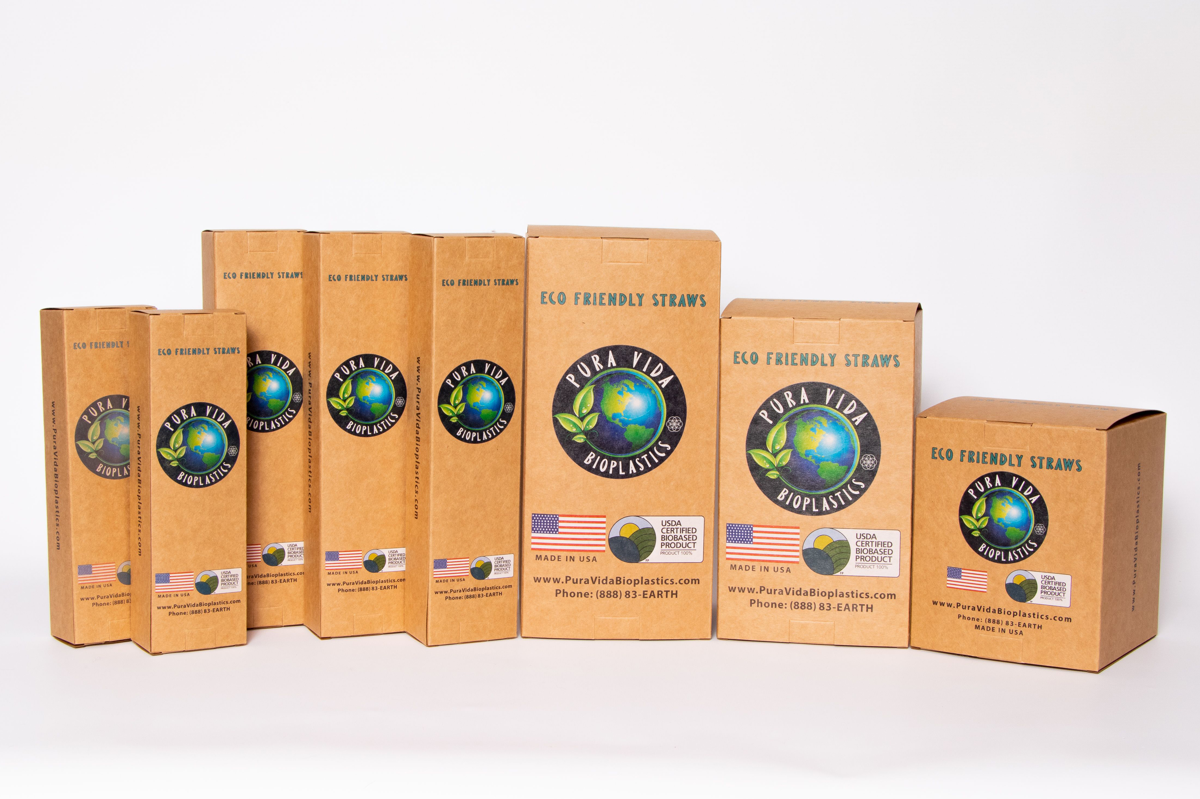
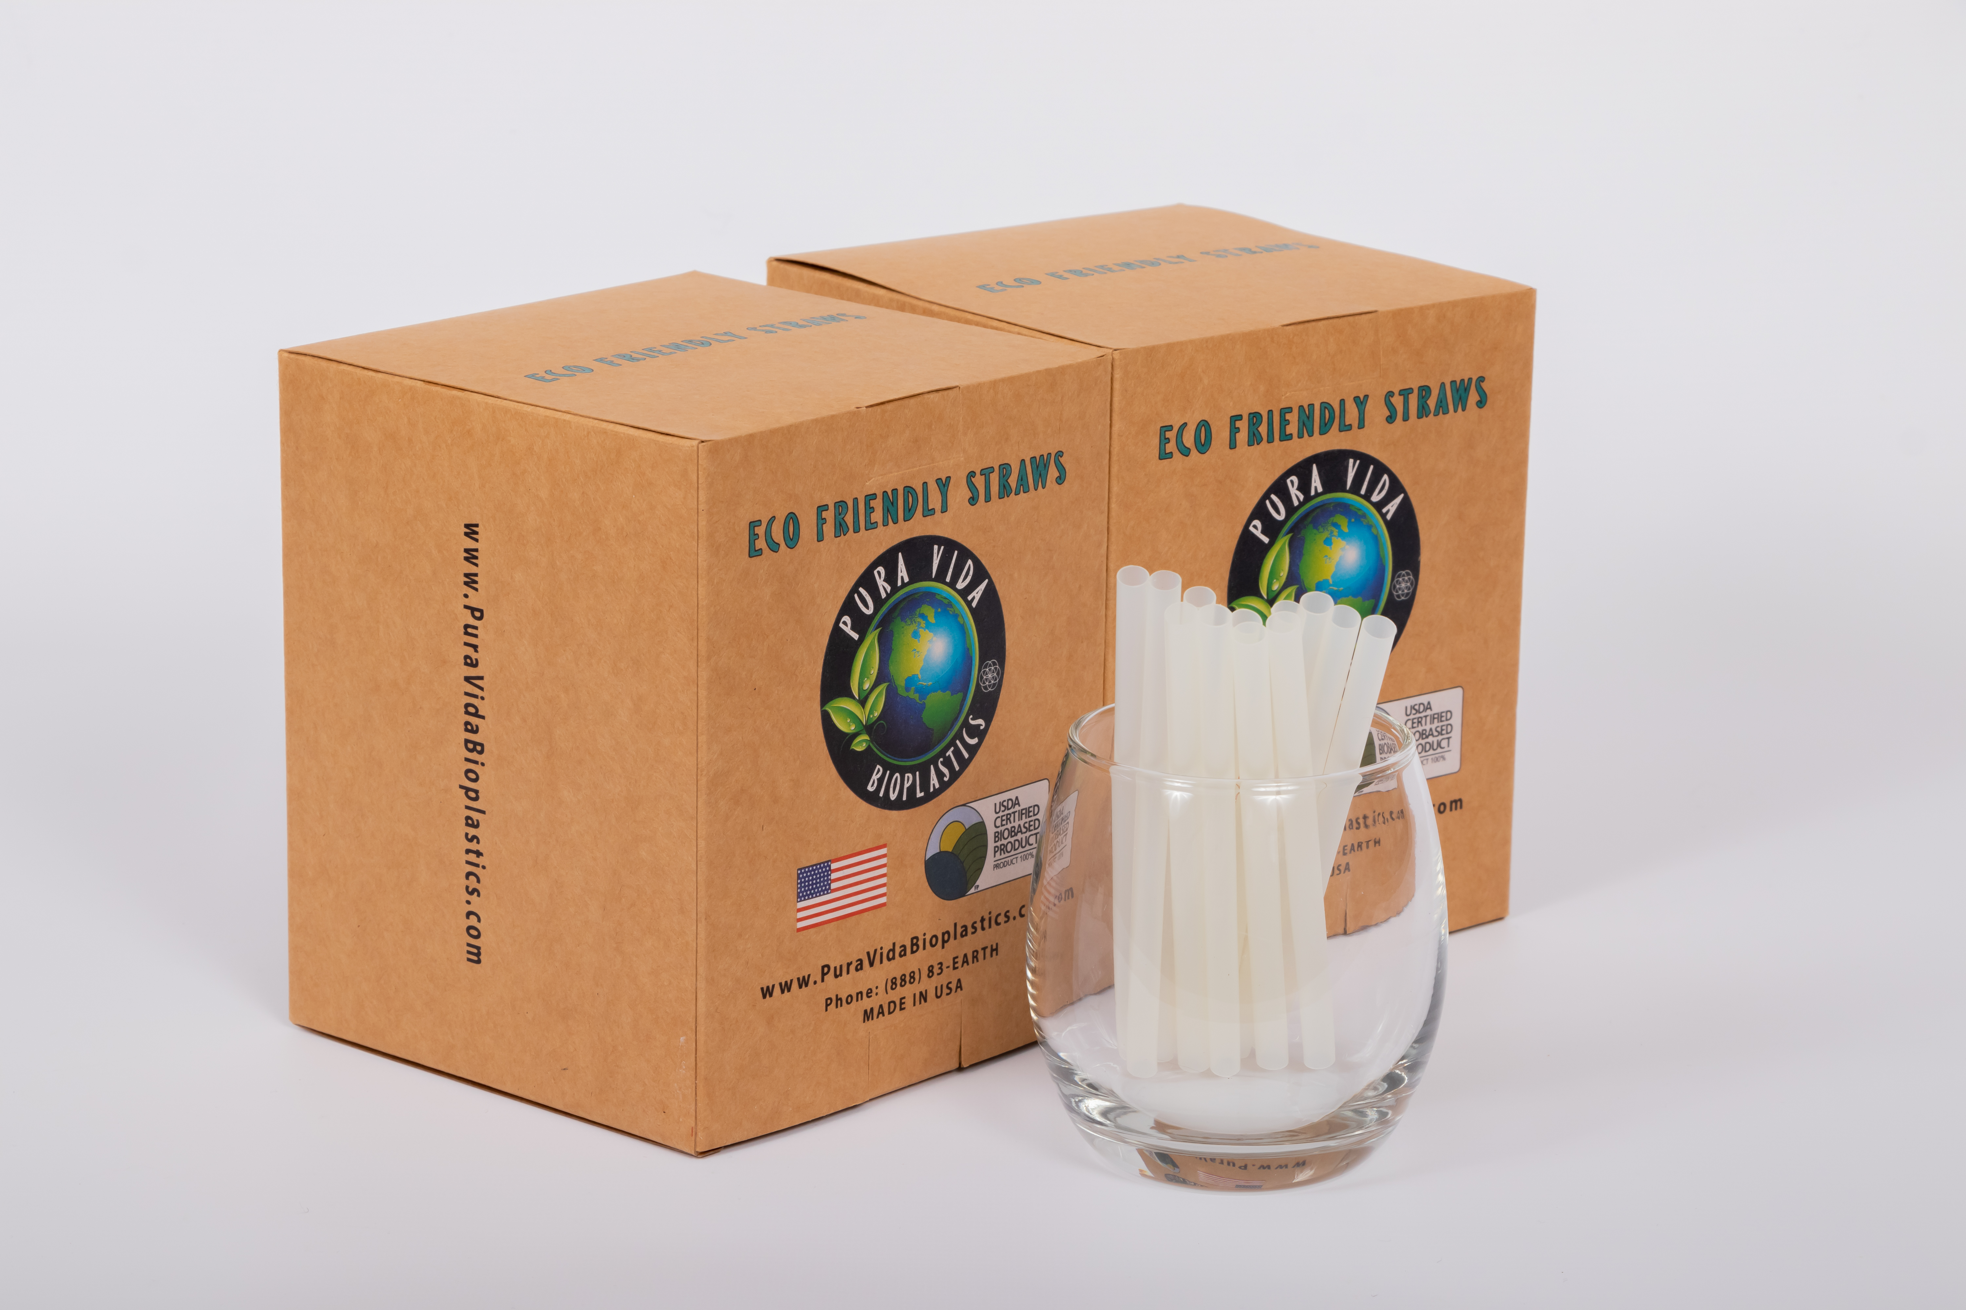
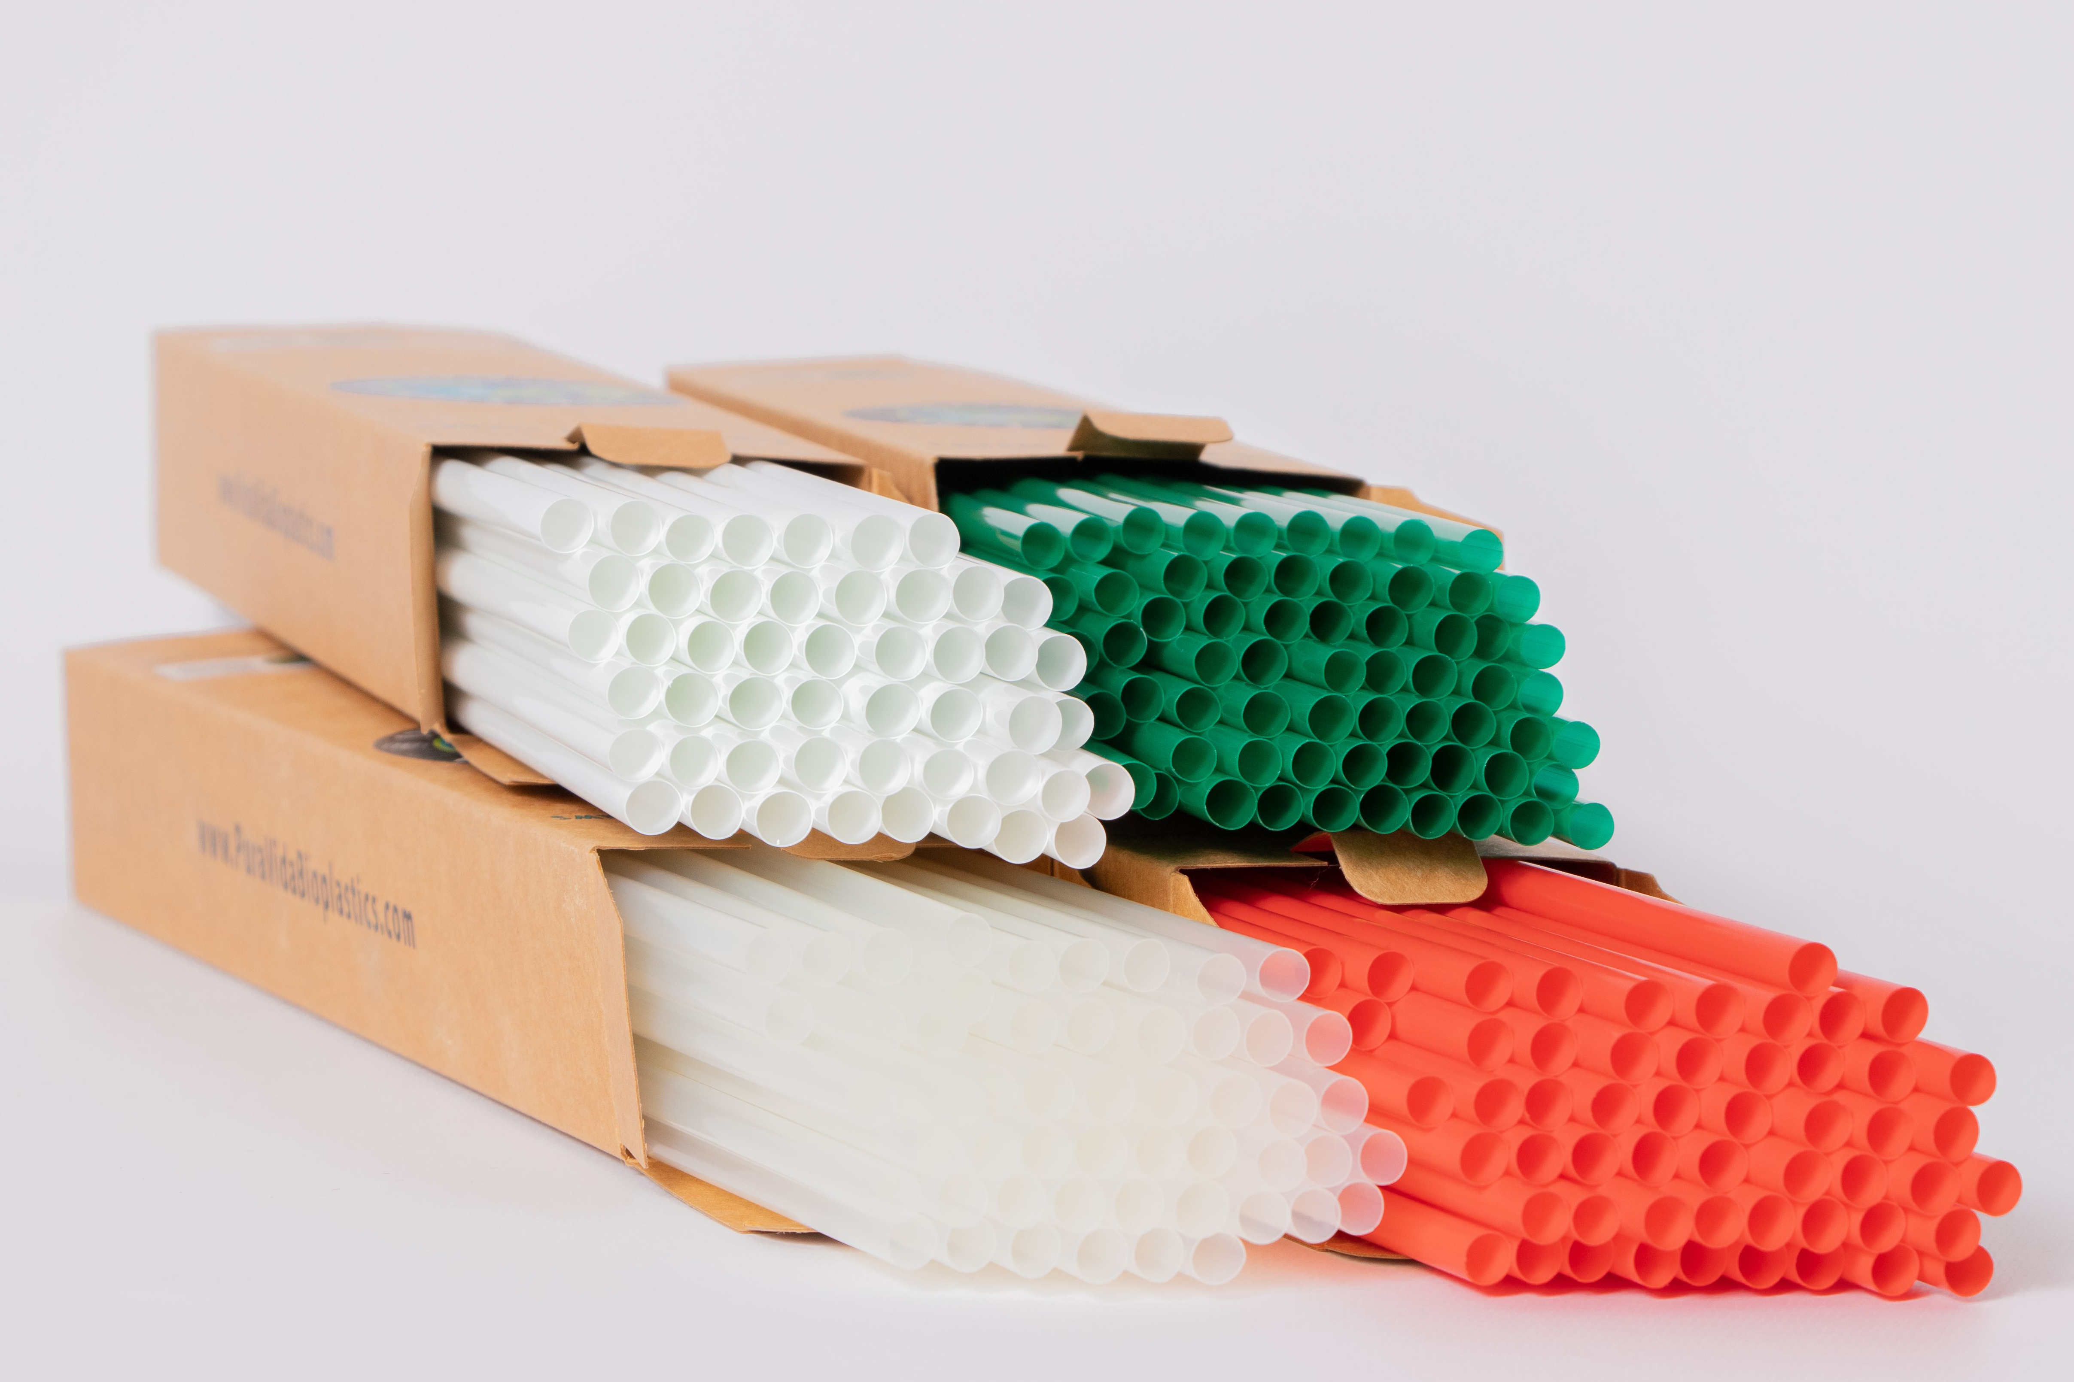
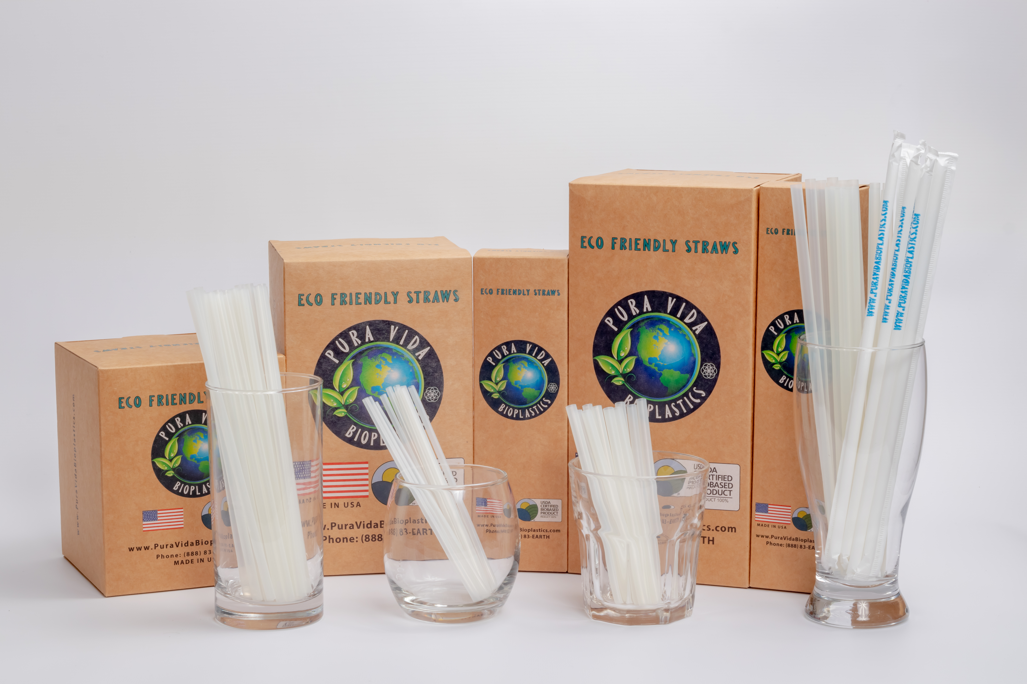
Products
Straw Size Options:
5”, 8” and 10”
Customized
Category Options:
Stir Sticks
Cocktail
Jumbo
Giant
Packaging Options:
Individual straw wrapped (Film or Paper)
Unwrapped
Bulk bagged
Multiple boxing volume Small, Medium or Large
White Label
Color Options:
Any color

Slide 11
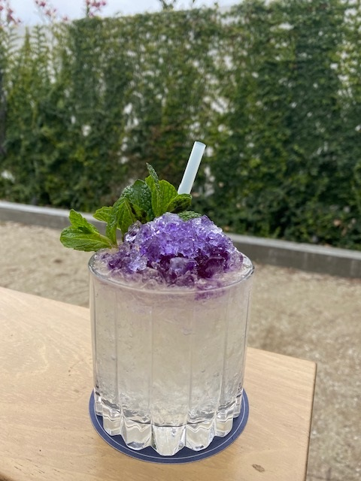
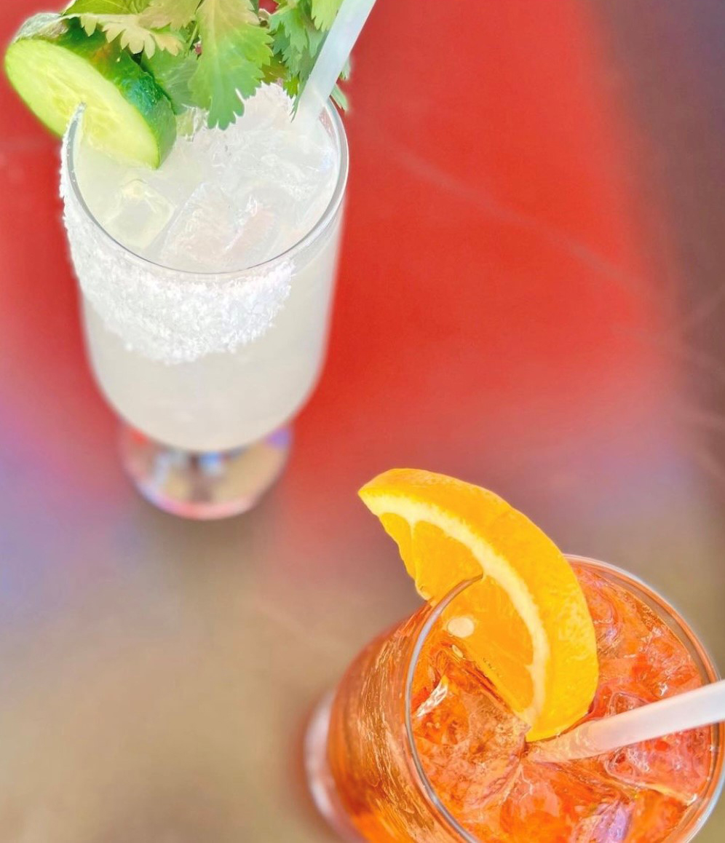
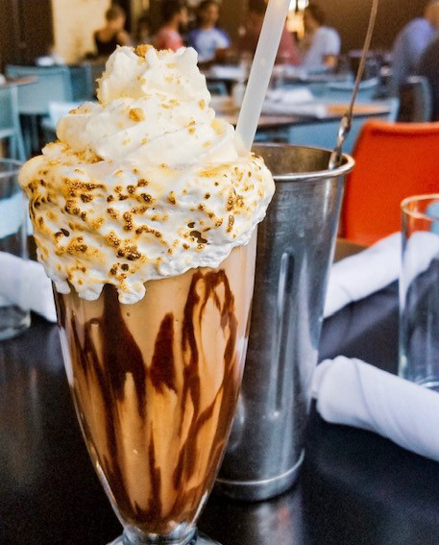
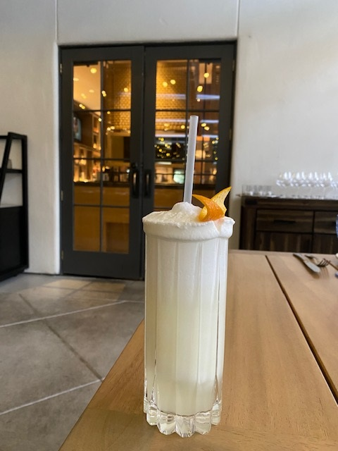
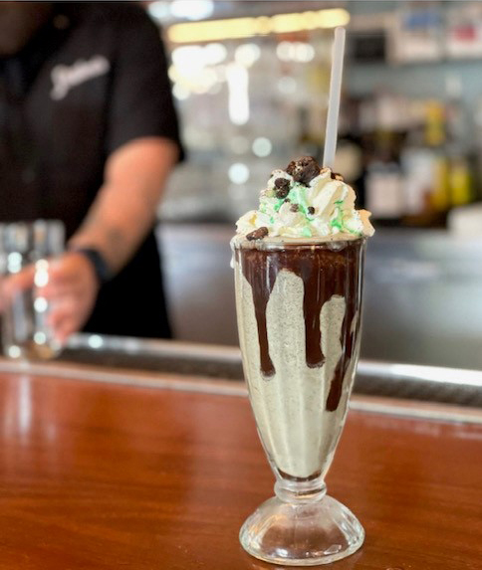
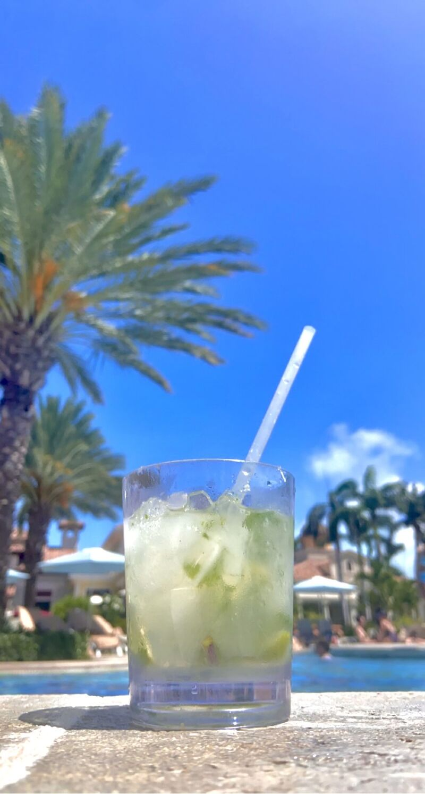
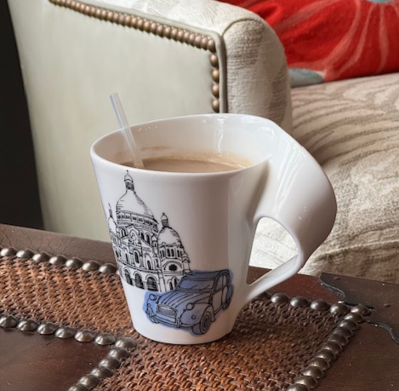
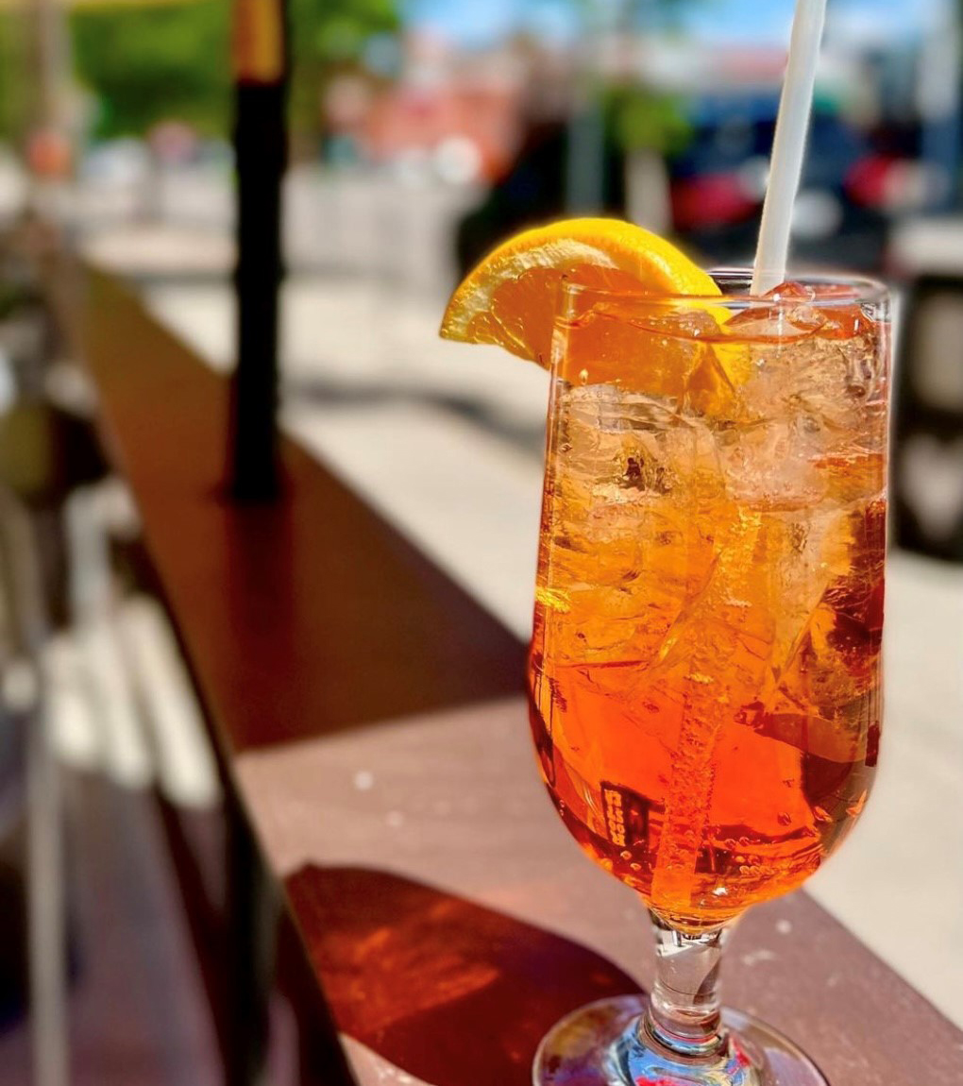
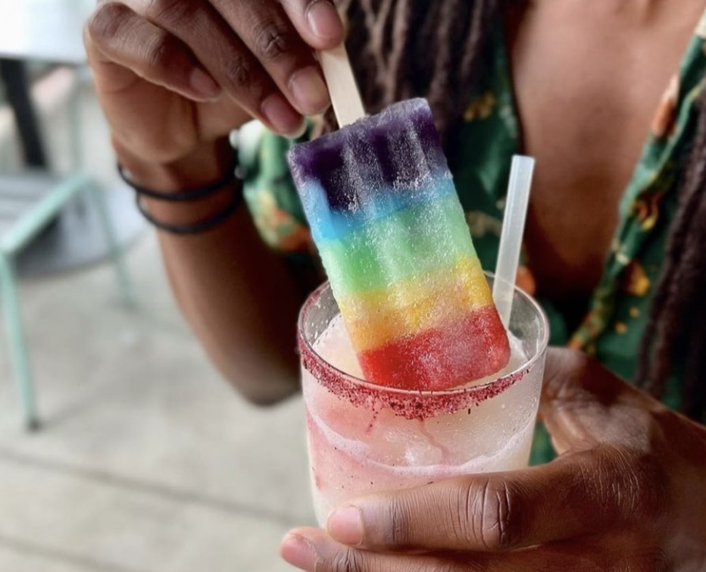
Usable in frozen beverages ……
Usable in hot beverages…

Slide 12
What customers are saying about our straws……..
“They work great even with an Oreo shake- our chunkiest of shakes!”
Joey Casanova
Director of Hospitality
Ace Eat Serve/Secret Sauce F&B
It's been long overdue, but as a leader in the restaurant, bar and hospitality industry, it's exciting for me to see a straw product finally exists that does the right thing for the environment and serves the product needs of our industry. I know there has been a lot of options out there, but none of them have been great in the last 5+ years and most are not truly compostable or break down properly. PURA VIDA Bioplastics has succeeded in meeting the expectation, GREAT STUFF!!!
Josh Mayo
Founder, Managing Partner
Spark Hospitality
“All straws at Steuben’s will be Pura Vida Straws!
Director of Hospitality
Joey Casanova
Steuben's Food Service

Slide 13
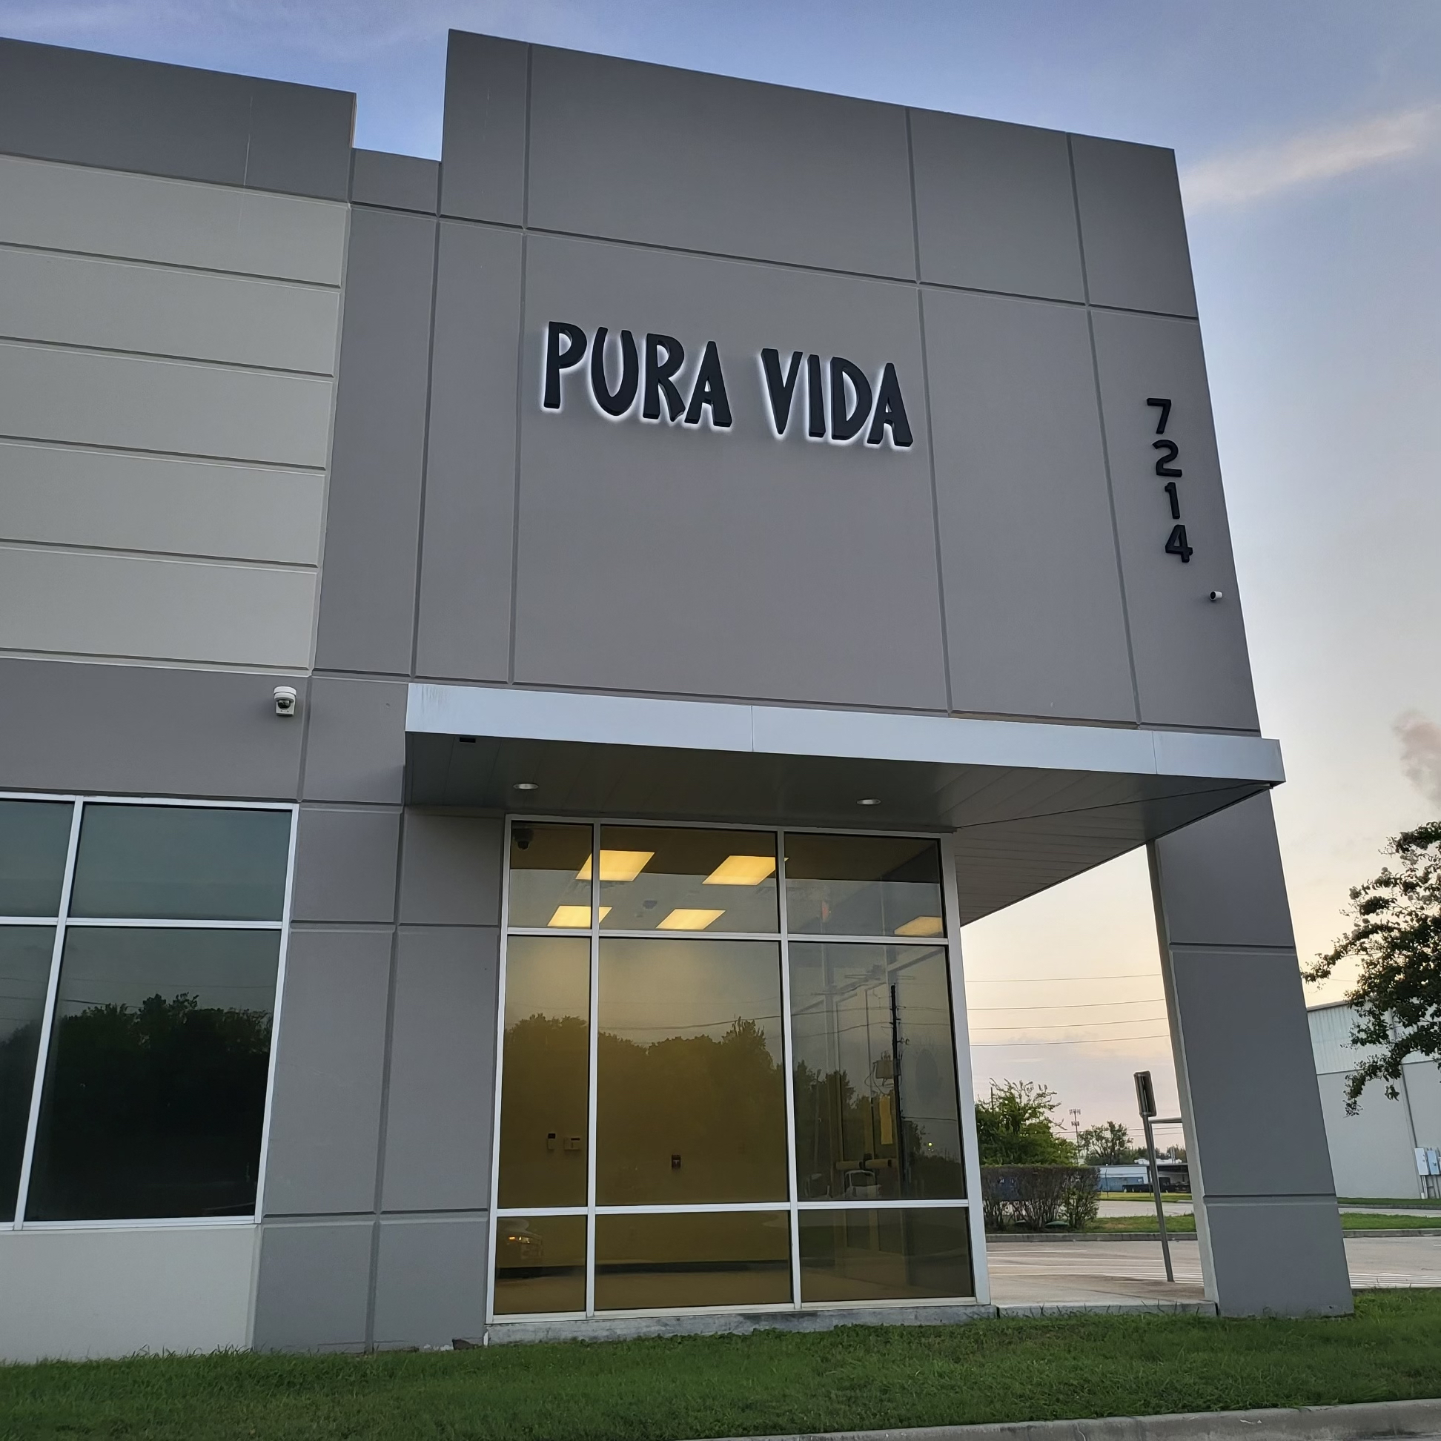
Current Manufacturing Capacity
Pura Vida Manufacturing Plant
7214 Harms Road
Houston, TX 77041
Year | Manufacturing Lines | Straws Produced / Month
2021 | 1 | 30,000,000
2022 | 5 | 150,000,000
2023 | 11 | 330,000,000

Slide 14
Our Expansion
Pura Vida Future Manufacturing Plant
Latin America
Canada
Caribbean
Pura Vida is currently negotiating our North American manufacturing expansion to the States of Georgia and Arizona to aide in logistics and demand of our customers.
Pura Vida is in negotiations with Bahamas, Costa Rica and Canada to expand manufacturing internationally.

